Slide 1
North Lincolnshire Association of Governing Bodies Celebrating Governance
Emma Knights
Chief Executive, NGA

Slide 2
Why is governance so important?
Governance determines who has the power,
who makes the decisions,
how other players make their voice heard and
how account is rendered
Institute on Governance, Canada

Slide 3
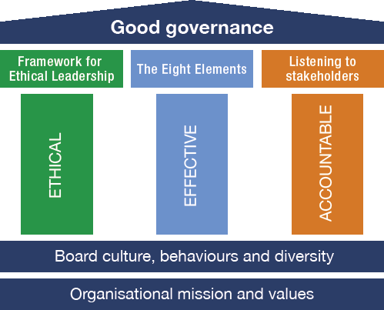
NGA webinar: what-does-good-governance-look-like

Slide 4
Three governance mind-sets

Slide 5
What the governance community tells us: Hot off the press from the Annual Governance Survey 2023

Slide 6
Pupils succeeding and flourishing
What do you want pupils to leave your school knowing, being and having done?
Having a love of learning
Personal development: spiritual, moral, social & cultural (SMSC)
Foster empathy and emotional resilience
Civic responsibility and participation
Relationships education and RSE
Religion and world views
PSHE (personal, social, health and economic) education
Measuring what we value, not valuing what we can measure
Listening to pupils: what did they tell you?

Slide 7
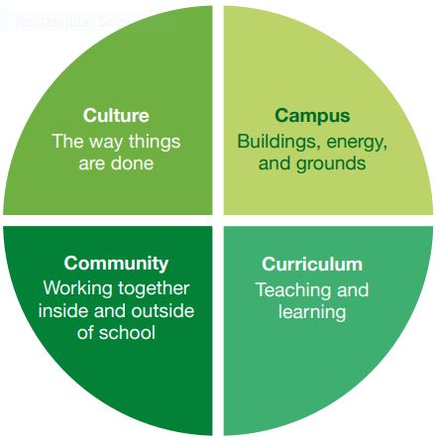
Put Environmental Sustainability & the 4C’s on your agenda:
NGA Greener Governance

Slide 8
Widening the lens: tackling educational disadvantage

Slide 9
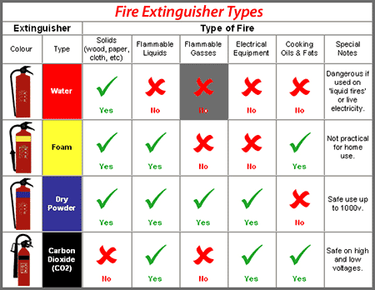
Does the response match the barrier?
Teaching and learning strategies
Reading/oracy/vocabulary
Pastoral support
Specialist support
Careers education
Extra curricular opportunities:
building cultural capital
outdoor activities
Parental engagement
Improving attendance
Mental health services
Family support & advice services

Slide 10
Educational disadvantage: the governing board’s role
NGA/disadvantage

Slide 11
Widening the lens of disadvantage – 25 top tips
School culture, expectations, coherence and principles
Remove the deficit discourse around disadvantage and its impact on learning and participation in school life. Disadvantaged pupils and their families are not a problem to be solved. They are our school community and held in high regard
Assessment of need, evidence-informed responses
Assessment, not assumptions, are at the heart of an effective approach. Start with the needs of the individual pupils and build a strategy around emerging themes and common issues
Priorities and partnerships
Poverty proofing is a key ingredient of inclusive schools where disadvantaged pupils are thriving. This should cover both the formal and informal curriculum, as well as uniform, equipment and other resources
Evaluation and implementation
Governors and trustees should play a key role in rigorous, dispassionate impact evaluation. Decouple impact evaluation from accountability.
Notes:
.

Slide 12
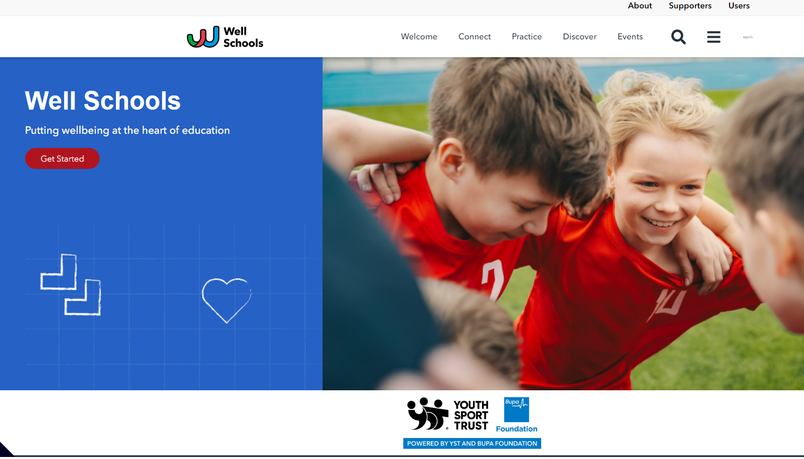
Well Schools Movement
Promoting a culture of well-being: the board’s role
NGA is proud to sit on the Well Schools Advisory Board
Free online community where schools can sign up and access resources shared by others on wellbeing. Powered by Youth Sport Trust
www.well-school.org

Slide 13
Before we move onto staff succeeding and flourishing…… any comments or questions

Slide 14
Engaging with staff

Slide 15
Promoting a culture of wellbeing

Slide 16
Headteacher CPD: a guide for chairs

Slide 18
What we expect....... updated in April 2022

Slide 19
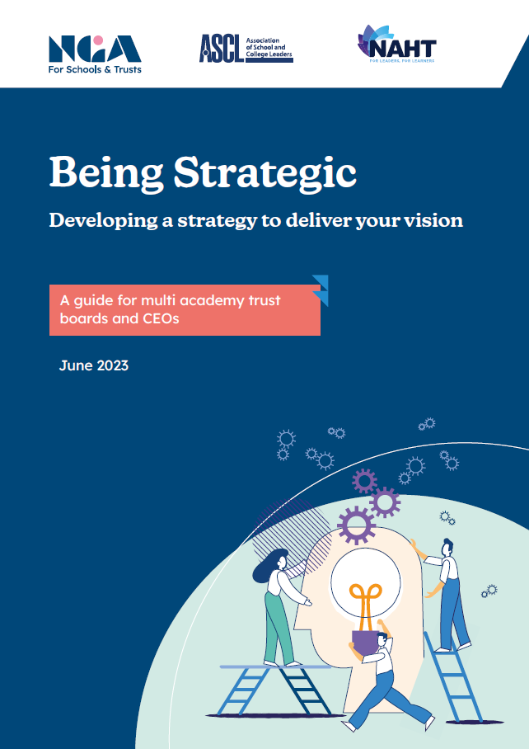
Being Strategic guides: updated this term

Slide 20
Before we move onto boards succeeding and flourishing…… any comments or questions

Slide 21
The core functions of school and trust governance
Ensuring clarity of vision, ethos and strategic direction;
Holding the executive leaders to account for the educational performance of the school and its pupils, and performance of staff;
Overseeing the financial performance of the organisation and making sure its money is well spent
Ensuring decisions take into account the views and experiences of stakeholders (pupils, parents, staff and the community)
And forthcoming changes

Slide 22
Where does your governing board sit?
High support
Supporters Club
Partners or critical friends
‘We’re here to support the head/CEO’
‘We share everything – good or bad’
Low challenge
High challenge
Adversaries or a court of enquiry
Abdicators
‘We leave it to the professionals’
‘We keep a very close eye on the staff!’
Low support
Governing the School of the Future

Slide 23
What good working relationships look like
Understanding respective roles
The board staying strategic and not stepping into the operational
Everyone is on board:
common mission & ethos, sense of purpose & direction, values lived
High expectations of each other
Investing time in the relationship
Professional recruitment & development of the board (as well as leaders & staff)
Building trust: no surprises, sharing of problems & public unity
All encouraging challenge of each other & debate: avoiding group think
All enabling & welcoming of stakeholder voices
The right balance between support and challenge
Questioning & listening: boards & leaders-building-great-relationships

Slide 24
Addressing volunteer recruitment
Assess the needs, the skills and the gaps
NGA’s 2022 survey showed being proactive & approaching recruitment differently tended to lead to success
Advertise widely (including LinkedIN) and explain the role
Use targeted networks for specific skills or backgrounds
eg your alumni; professional networks; Reach
Have someone candidates can speak to further
Don’t forget to offer expenses
Your governance professional is there to support
The Right People Around The Table www.nga.org.uk/RPATT
Includes a role description; advice on elections & what to put in adverts, questions for an interview, and more

Slide 25
Stronger together at community level Engaging with parents & carers
NGA knowledge-centre/engaging-with-parents-and-carers
A guide to engaging with parents and carers
Questions for governing boards to ask parents
Template governing board report to parents
NGA-Learning-Link-e-learning/Stakeholder-engagement
Stakeholder engagement e-learning module:

Slide 26
Flexible e-learning created to support new and experienced governance roles:
Over 65 high-quality e-learning modules to choose from
Designed for busy governors, trustees and governance professionals
Modules are written by experts and cover all the essentials for an effective governing team
Available when you need it to learn at your own time and pace
Learning Link is time-saving and affordable
Fill knowledge gaps and tackle challenges with confidence
“Outstanding quality and very useful in enhancing
my knowledge ”
Learner
Membership | Learning Link
NONE | £198
GOLD | £99
STANDARD | £139
nga.org.uk

Slide 27
Thank you
NGA’s Regional Lead for North Lincolnshire:
Katherine.Soanes@nga.org.uk

