Slide 1

Wellbeing in schools
With an introduction to ELSA

Slide 2
The wellbeing offer in North Lincolnshire schools and colleges has developed in response to the needs of our children and young people.
This includes the Thrive Approach and With Me in Mind as well as further bespoke and targeted interventions and training such as ELSA and trauma awareness.
It is important to understand that the principles of these fit and complement one another. This can enable and empower our staff to feel equipped in their skills and knowledge of relational care, emotional growth and therefore improve children and young people’s competency to engage in education and learning.

Slide 3
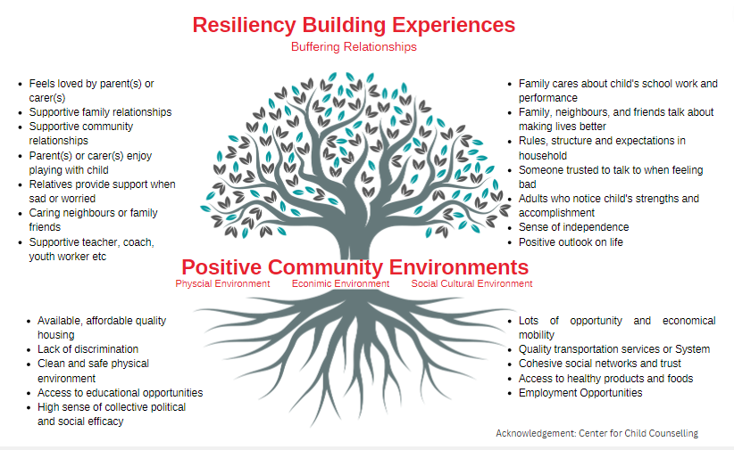

Slide 4
The Ofsted framework requires Ofsted inspectors to routinely assess and report on pupils’ behaviour. Inspectors will consider how well leaders and staff create a safe, calm, orderly and positive environment, and the impact this has on behaviour and attitudes.
Inspectors will consider how well leaders and staff create a safe, calm, orderly and positive environment, and the impact this has on behaviour and attitudes.
There has been a focus on promoting whole school or college wellbeing for several years and the 8 Principles have been a fundamental approach that has guided the roll out of the Mental Health in Schools Agenda and have structured the DfE approved training for Senior Mental Health Leads.
https://www.gov.uk/guidance/mental-health-and-wellbeing-support-in-schools-and-colleges

Slide 5
Notes:
This is a whole setting approach supporting at the right time development adapting relationships, ethos, curriculum and environment to meet the needs of all children and YP as they arise naturally in line with age related expectations
The approach responds to key times using relational strategies to meet the needs of children and YP when they are experiencing change, loss or significant life events
Using targeted and reparative work to fill the gaps where children’s needs have not been met at the right time in their earlier development.

Slide 6

What is ELSA ?
The ELSA (Emotional Literacy Support Assistant) Course is designed to build upon the capacity of schools to support the emotional needs of their students from within their own resources (Shotton & Burton, 2019).
Notes:
The ELSA project is an initiative designed to help schools meet the needs of emotionally vulnerable pupils from within their own resources.
ELSAs are emotional literacy support assistants working in schools. They:
help children recognise, understand and manage emotions to increase success
plan and deliver individual (and small group) support programmes
receive training and supervision from educational psychologists.
Children learn better and are happier in school if their emotional needs are met.
When children’s emotional and cognitive energy is focused on their personal and interpersonal difficulties, their capacity to concentrate on learning new information and skills is reduced.
ELSAs plan and deliver programmes of support to children identified within school as likely to benefit from additional help to increase their emotional literacy. Programmes would normally last between half to one term, and occasionally a little longer.
Children may for example receive support to recognise and manage their emotions, raise their self-esteem, improve peer relationships, recover from significant loss or bereavement, and resolve conflict effectively.
Most of the support is individual and builds on the relationship of trust that is developed between pupil and ELSA. Some skills will be enhanced through small group work, particularly social and friendship skills (although some children will need individual support first).
It is an initiative developed and supported by educational psychologists, who apply psychological knowledge of children’s social and emotional development to particular areas of need and to specific casework.
The training has been developed by educational psychologists and ELSAs are provided with regular supervision to develop their understanding, skills and practice.

Slide 7
Training Modules
Raising Emotional Literacy Awareness
Active Listening and Reflective Conversations
Building Resilience and Self-esteem Part 1
Building Resilience and Self-esteem Part 2
Managing Emotions
Social and Friendship Skills
Supporting children through Loss, Bereavement & Family Break Up
The use of story in ELSA work

Slide 8

Supervision
Notes:
An essential part of the ELSA initiative is the on-going support of educational psychologists to continue building the competence and confidence of ELSAs. Ideally this should take place in local cluster groups with the EP who works with those schools.
Sets the training programme apart from many similar CPD packages and integral to ELSA programmes
The reason for grouping secondary ELSAs together for supervision is that some different issues pertinent to adolescents will need to be considered. While universal training is perfectly appropriate, secondary ELSAs will need the opportunity to discuss specific needs with others likely to be dealing with similar issues.
There is a distinction between managerial and clinical supervision. ELSAs are line-managed within their own schools. Clinical supervision involves attention to the psychology behind needs and behaviour.
Within supervision groups useful problem-solving approaches can be modelled using the expertise of the supervising EP.
The groups also offer an opportunity to build supportive relationships between ELSAs, enabling the sharing of ideas and possibly some resources.
Arrange and facilitate sessions
Record attendance
Follow up non-attendance
Negotiate group working agreement
Provide professional support to ELSAs
Provide psychological perspective on pupil (and ELSA) needs to support planning
Encourage shared problem-solving
Uphold principles / guidelines of ELSA project
It is the role of the supervising EP to ensure that work carried out by ELSAs falls within the legitimate remit of the ELSA project and is carried out in accordance with guidelines given in training. In particular they will help to ensure that ELSA work is primarily proactive planned support rather than ad hoc and reactive in nature.

Slide 9
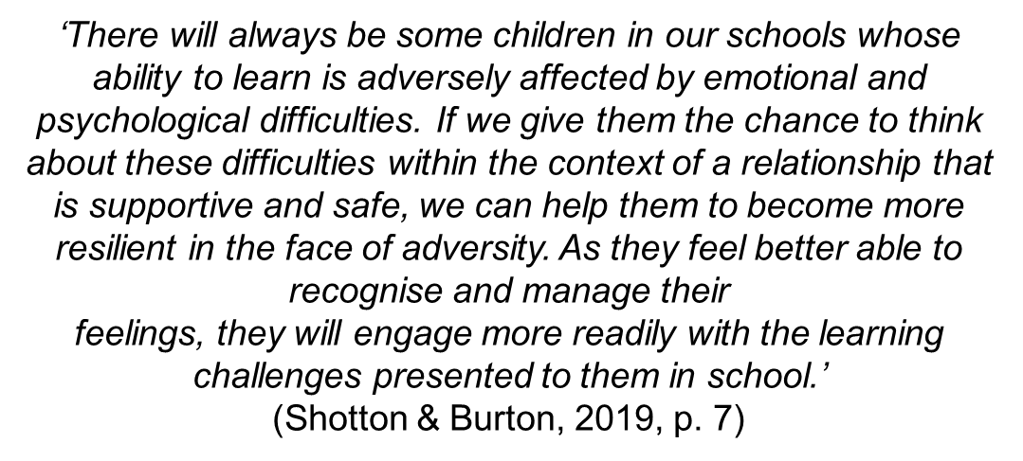

Why is emotional literacy important?
Notes:
Why is emotional literacy important? (Estelle Morris quote)
Our educational responsibilities don’t begin and end with curriculum targets.
We will always have a responsibility to support the development of ‘the whole child’.
It is widely recognised that children are more open to learning and are happier in school if their emotional needs are addressed (Shotton & Burton, 2019).

Slide 10

The benefits of having an ELSA in school…
Notes:
The benefits of focusing on emotional literacy
Peter Sharp used to be Principal Educational Psychologist in Southampton, and worked with other managers within education to make emotional literacy one of the top priorities in the educational development plan in the city.
Why? :
As we’ve already said, children learn more effectively when they feel OK.
If we help children to manage their emotions more effectively and therefore learn better, then we will help to raise standards.
When children feel better they get more enjoyment out of their learning
Developing children’s ability to mange their emotions more effectively reduces their stress levels. (Together with Adrian Faupel and Liz Herrick, Peter Sharp has done a lot of work on anger management. We will be looking at this on Day 3.)
Negative cycles can be broken by raising emotional competence and giving children alternative strategies for managing stress.

Slide 11
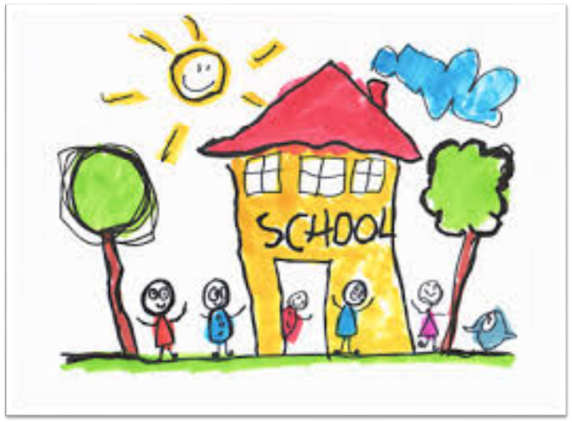
School commitment
Ensuring:
that ELSAs are released for all training and supervision sessions
that they have ring-fenced time for planning and delivery of regular sessions
that they have a suitable space (pleasant and semi-private)
that they have a budget which allows them to purchase new resources to develop their work
that finance is protected to maintain the ELSA role year on year.
Notes:
Equally important to successful outcomes is the commitment of the school in ensuring:
that ELSAs are released for all training and supervision sessions
that they have ring-fenced time for adequate planning as well as the delivery of regular sessions to the children referred for support
that they have a suitable space (pleasant and semi-private) where they can work with pupils
that they have a budget which allows them to periodically purchase new resources (games, books, puppets) to develop their work
that finance is protected to maintain the ELSA role year on year.

Slide 12
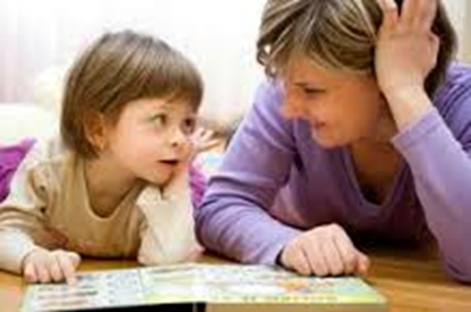
Essential qualities for ELSAs
be able to build positive relationships with children
to think creatively about how to facilitate the development of new skills
must be able to work independently
a Teaching Assistant wishing to become an ELSA will need to have the desire to learn.
Notes:
It is vital for head teachers to think carefully about their choice of staff to train as ELSAs.
An prospective ELSA needs to have shown herself or himself to be able to build positive relationships with children who are not necessarily easy to get along with – both those who act out and those who are withdrawn.
That in itself is not enough. The initiative is predicated on the ability of ELSAs to think creatively about how to facilitate the development of new skills in the young people with whom they work. They must be able to work independently because they will be required to develop their own programmes of work, writing session plans and reflecting on outcomes.
Above all, an LSA wishing to become an ELSA will need to have the desire to learn, as there is a considerable amount of new learning involved in this role.

Slide 13
Course Details
DATES
Training Days:
Wednesday, 27th September 2023
Wednesday 11th October 2023
Wednesday 1st November 2023
Wednesday 15th November 2023
Wednesday 29th November 2023
VENUE
Normanby Hall Country Park, Normanby, North Lincolnshire DN15 9HU
Notes:
You'll need to decide on who is best placed for the role of ELSA; send on the details and we will look at how to manage the group as we have capacity for 18 maximum in one cohort.
We will then end you a form to complete

